Slide 1
Mapping the Ramifications of Lithium Extraction in the Western United States
Group Four: Benjamin Tarver, Shining Zhang, Alex Sieh, Gensheng Lin, Ashley Garcia

Slide 2
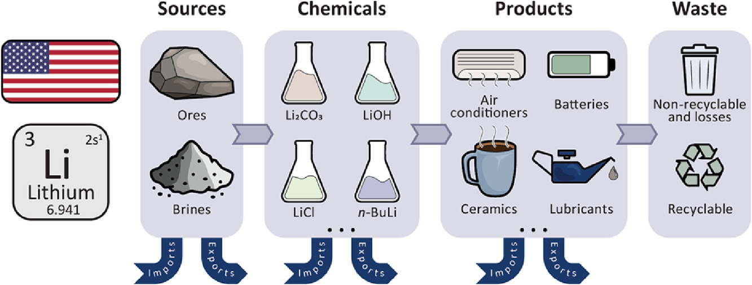
Context
How does lithium mining in the western United States impact nearby communities, especially Indigenous communities?
Notes:
Our main driving question for this project is: How does lithium mining in the western United States impact nearby communities, especially Indigenous communities? The context for this driving question is that as electric vehicles and so-called “smart devices” become more prevalent in our everyday lives, the demand for lithium and other rare earth metals used in batteries and computer hardware is skyrocketing–the pursuit of lithium reserves has been referred to as the “white gold rush” in popular media. This rush for rare earth metals, however, has well-documented consequences for frontline communities in areas with a prevalence of rare Earth metals (such as the poisoning of groundwater reserves). In the “Lithium Triangle” in South America, groundwater reserves may be entirely depleted, destroying entire ecosystems and forcing Indigenous peoples who’ve lived in the region since time immemorial to move off their lands, largely in service of our push to promote electric vehicle adoption. Now some of those same risks are being run/are planning to be run in the Western US, especially in the state of Nevada on Indigenous reservation land, as will be shown in a map on the subsequent slide.

Slide 3
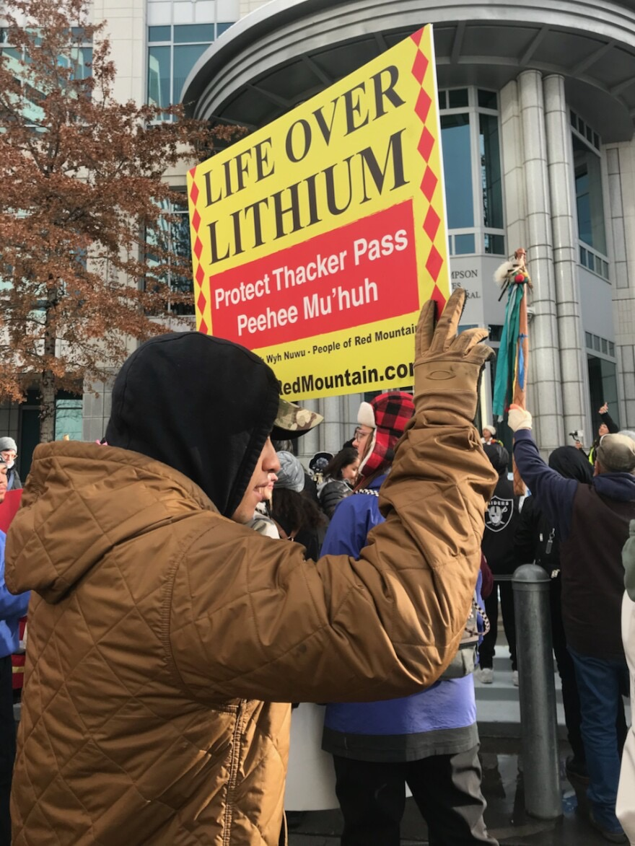
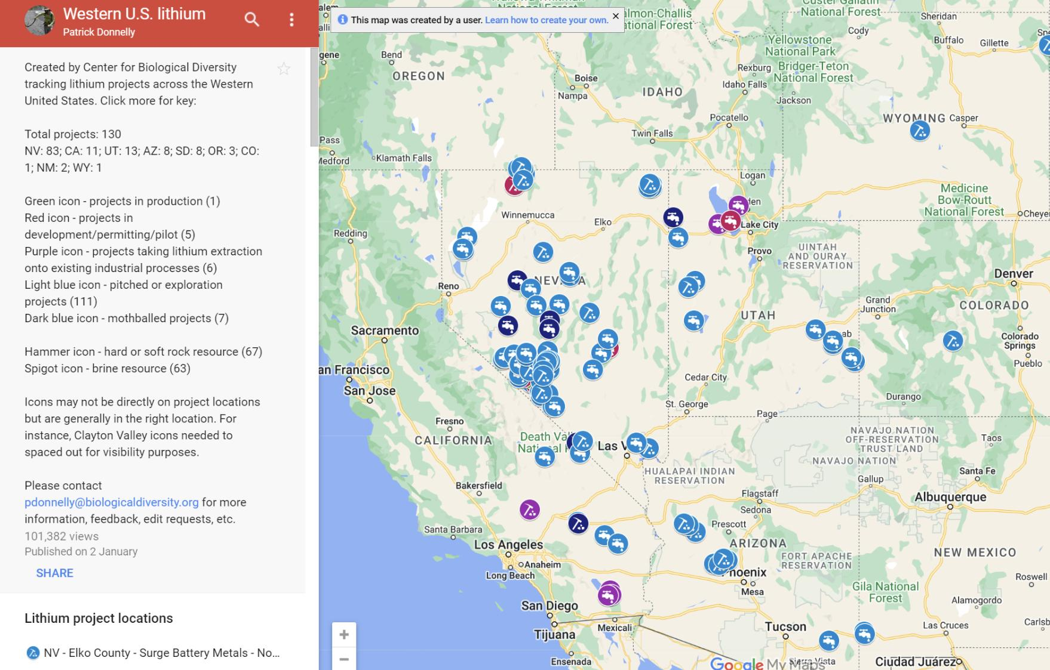
Impacts & Group Commitments
Notes:
The extraction of lithium can have environmental impacts that draw similarities to those associated with the extraction of fossil fuel.
lithium mining has ecological and environmental costs, impacting many habitats and species. To produce just one ton of lithium carbonate requires the evaporation of 500,000 gallons of lithium brine collected from underneath the salt flats. This is not to mention the energy intensity of lithium mining, which often necessitates the usage of fossil fuel-powered heavy equipment and machinery which further contributes to the pollution of our atmosphere an nearby communities. An example of another impact is shorebirds, which rely on the habitats of the Altiplano salt flats in the Lithium Triangle, are among the species most vulnerable to the impact of lithium mining.
Given all these consequences, we’re hoping to map various socioeconomic and health variables amongst these communities to see if these communities are at particularly heightened risk to the consequences of lithium mining. It would also be prudent to map out these communities’’ reliance on groundwater to see if there are any relevant intersections there (i.e. might the impacts be similar as those in the Lithium Triangle?)
We’re hoping to get as much information as we can from direct sources (i.e. from the frontline communities themselves or from non-profits that directly work with the communities), but in instances where that is not possible, we will make sure that the sources we pull information from are vettable/credible sources. We are starting out by pulling information from well-known sources such as NPR, The Guardian, and Time, but hope to focus in on more local sources as time goes on with the project.
The audiences of our project include students, academics, and members of the general public interested in climate justice and the ramifications of the “green technology revolution.” We will ensure that our project materials are fully accessible online to all who wish to view and interact with them.
We also want to acknowledge our positionality: as UCSD students, we conduct this research from a position of relative privilege, and we do not take this task lightly. We believe there is a clear demonstrated need by the continued pursuit of lithium mining in the western United States for research and advocacy work to be conducted to educate the general public about the consequences of lithium mining, especially as these consequences can be especially harsh for Indigenous communities living near lithium mining operations, and we intend to be carriers of that message.

Slide 4
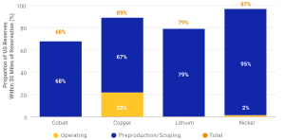
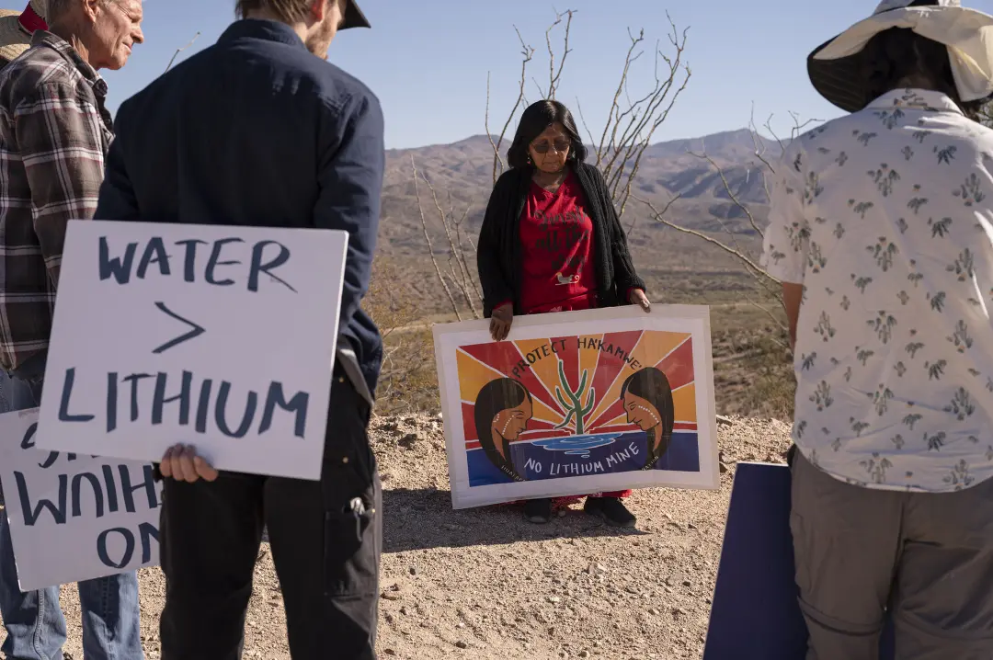
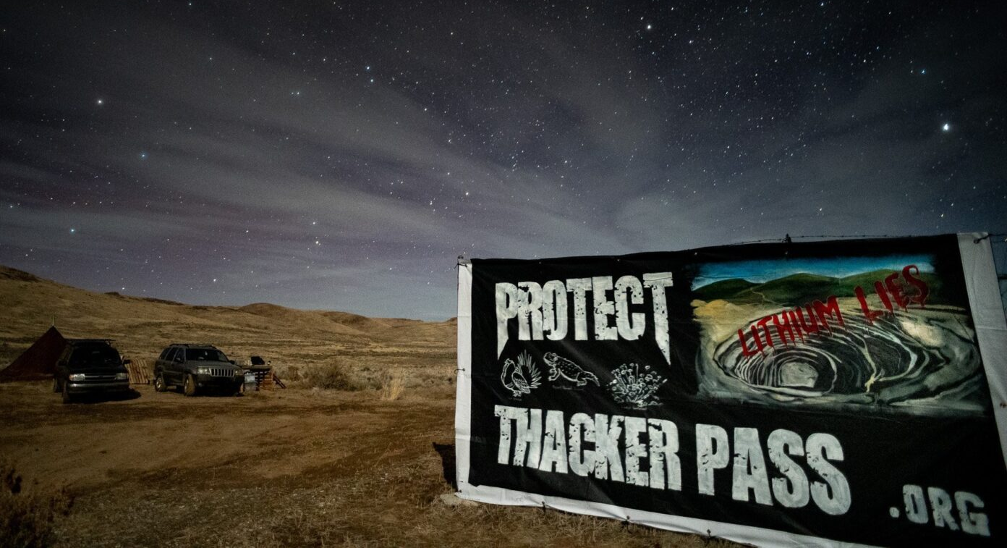
Impacts (2)
Below: Arizona
Top right: % cobalt, copper, lithium, and nickel mines within 35 miles of a reservation
Bottom right: Nevada
Notes:
Besides the impacts on ecosystems – brine extraction damaging salt flats and lithium mines, which tend to be in the desert, displace and destroy rare desert habitats like sagebrush – lithium extraction harms the local populations as well. Many prospective lithium mines are near indigenous reservations and some are even slated to be built on sacred sites. Additionally, mining jobs tend to bring many newcomers to the area, and there are complaints on this point as well, as mines tend to increase violent and drug crime in the area.

Slide 5
Challenges
We might have some trouble with how general our project is at this stage: "how does lithium production affect people and the environment" is what this boils down too, and it can be pursued many ways – will we talk about demographic shifts and harm to indigenous communities, or will we talk about the habitats of birds and the destruction of plant life, which in the end spill over and wrap around? We hope to narrow down our scope as we progress and find more avenues of approach.

